Slide 1
G
Tomato Killer
AI TUTORING SYSTEM
To make studying ease and affordable

Slide 2
1
First Part
Overview of
project objectives

Slide 3
Do you know how many children, adolescents and youth will still be out of school globally in 2030?
225 Million
Do you know how many adults around the world are still illiterate?
750 Million
——————UNESCO

Slide 4
VISION
USER STORIES
To make studying EASE & AFFORDABLE
As a user, I want to have my own account, so that I can save the learning process.
As a user, I want to choose difficulty of the course, so that I can choose suitable course.
As a user, I want to have a test after I learned course, so that I can check my effectiveness of my study.
USER STORY

Slide 5



KEYWORDS
CHALLENGE
HOW TO MAKE SURE THE ANSWER GIVEN BY AI IS CORRECT
Give a Standard Answer
Generate Answer & Explanation
ADMINISTRATORS
AI
Answer & Explanation

Slide 6
2
SECOND PART
Technology Stack

Slide 7











TECHNOLOGY STACK
FRONT-END
BACK-END
INFRASTRUCTURE

Slide 8
WHY？
———Take test

Slide 9
TECHNOLOGY STACK
A common and proven solution & Plenty information available for both learning and troubleshooting.
No need to use complicated methods to combine them.
Docker can make our service easy to deploy, K8s has better scaling.
FRONT-END
BACK-END
INFRASTRUCTURE

Slide 10
TECHNOLOGY STACK
Open Source: No additional fees.
Spring Boot: Simplifies transaction handling.
FRONT-END
BACK-END
3. MySQL & MyBatis: Offers scalable, flexible database control.
4. MVC Architecture: Facilitates separation of user interface and business processing.
INFRASTRUCTURE

Slide 11
TECHNOLOGY STACK
FRONT-END
Componentization: Makes code more reusable and maintainable.
Efficient Performance: Improves rendering efficiency through the virtual DOM.
Robust Community Support: Benefits from a large community and a wealth of third-party library support.
BACK-END
INFRASTRUCTURE

Slide 12
3
THIRD PART
Data sources

Slide 13

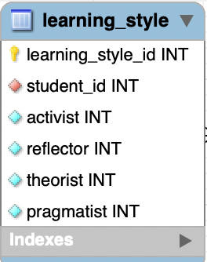
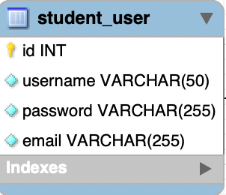
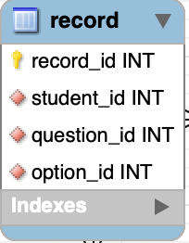
Data Sources
USER DATA
TUTORIAL VIDEOS
QUESTION

Slide 14

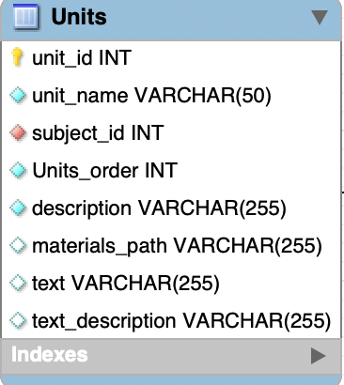
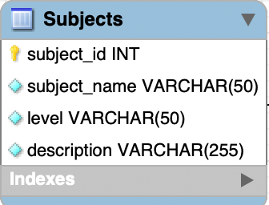
Data Sources
USER DATA
TUTORIAL VIDEOS
QUESTION

Slide 15


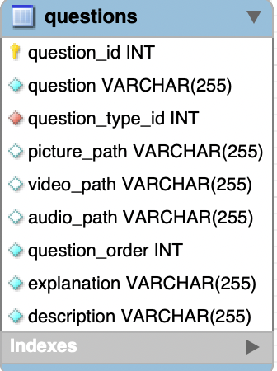
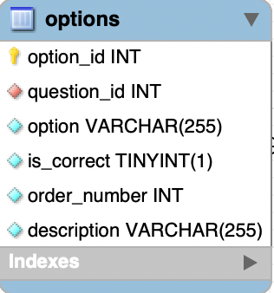
Data Sources
USER DATA
TUTORIAL VIDEOS
QUESTION

Slide 16
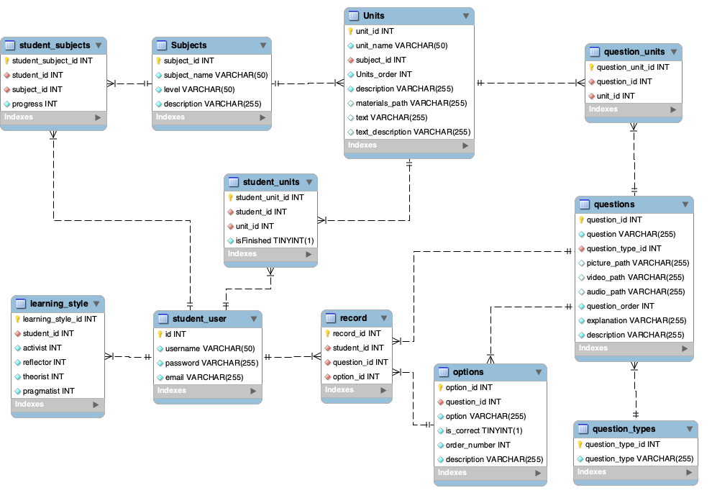

Slide 17
4
FOURTH PART
Key technical challenges

Slide 18
TECHNICAL CHALLENGES
1. TECHNOLOGY INTEGRATION
2. INTERFACE STANDARDIZATION
3. AUTO-SCALING PROBLEM

Slide 19
1. TECHNOLOGY INTEGRATION
Follow Official Documentation and Recommended Practices: Adhering to official guides and best practices can minimize errors and incompatibility issues during integration.
Use a Unified Project Management Tool: Tools like Maven can be used to manage dependencies and ensure version compatibility.
Incremental Integration and Testing: By gradually integrating and testing new technologies at each stage, issues can be identified and resolved earlier.
SOLUTION

Slide 20
2. INTERFACE STANDARDIZATION
Documentation: Ensure that each interface's functionality, inputs, outputs, and error handling are detailed in comprehensive documents.
Adopt Uniform Design Principles: Establish and adhere to consistent naming conventions and structures, use JSON for data transmission, and primarily develop based on database data formats.
Utilize Interface Testing Tools: Use tools like Postman for automated interface testing to ensure that the interfaces work as expected.
SOLUTION

Slide 21
3. AUTO-SCALING PROBLEM
Problem Solution: Setting up probes
Details: When auto-scaling, when the containers in the pod are deployed, the pod will show the ready status, in this case the external traffic will go to the pod directly. but in the pod, our service is going through the startup process, which is not consistent with the readiness shown in the pod. To resolve the issue, we use probes. The probe makes a request to our API and only when the service returns a status code of 200-400, the kublet changes the pod state to ready, thus avoiding this problem.
SOLUTION

Slide 22
5
FIFTH PART
Evaluation

Slide 23



EVALUATION
SYSTEM
USER
Pod
Metrics
Node
Metrics
Networking
Metrics
Cluster
Metrics
User
Survey
Tree
Test
A/B
Test
SYSTEM
Performance

Slide 24
Pod availability: It's important to monitor the state of your pods to ensure that your applications are available.
Pod restarts: Frequent restarts could indicate that something is wrong with a pod.
Networking
Network send/receive: High network activity might indicate an issue or bottleneck with your service or application.
Error rates: High error rates could point to issues with your application or network.
Pod Metrics
P
N
Request rates: High request rates to your cluster could point to increased demand for your applications or services.
Error rates: High error rates for requests could indicate issues with your application or service.
C
N
Node Metrics
Node availability: Monitor the availability of your nodes to ensure that they're healthy and can schedule pods.
CPU Usage: High CPU usage could indicate that you need to allocate more resources to your nodes.
Memory Usage: Like with CPU usage, high memory usage can indicate that you need to allocate more resources.
Disk I/O: Disk read and write speeds can affect application performance.
Cluster

Slide 25
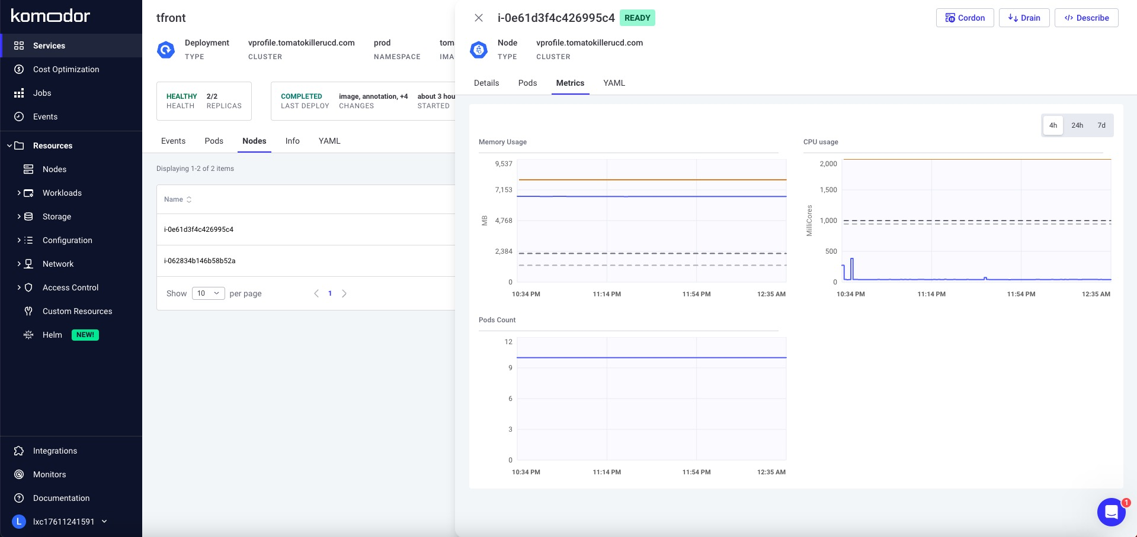

Slide 26

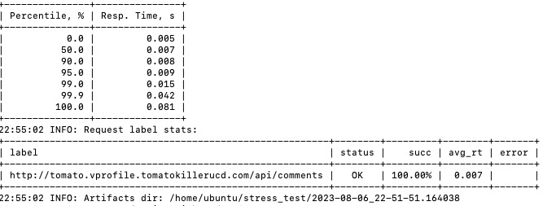
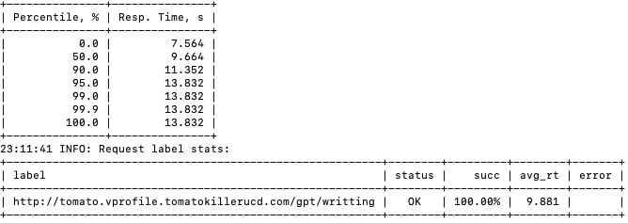
SYSTEM PERFORMANCE
Average response time for learning requests: 0.007
Average response time for GPT-related requests: 9.881

Slide 27

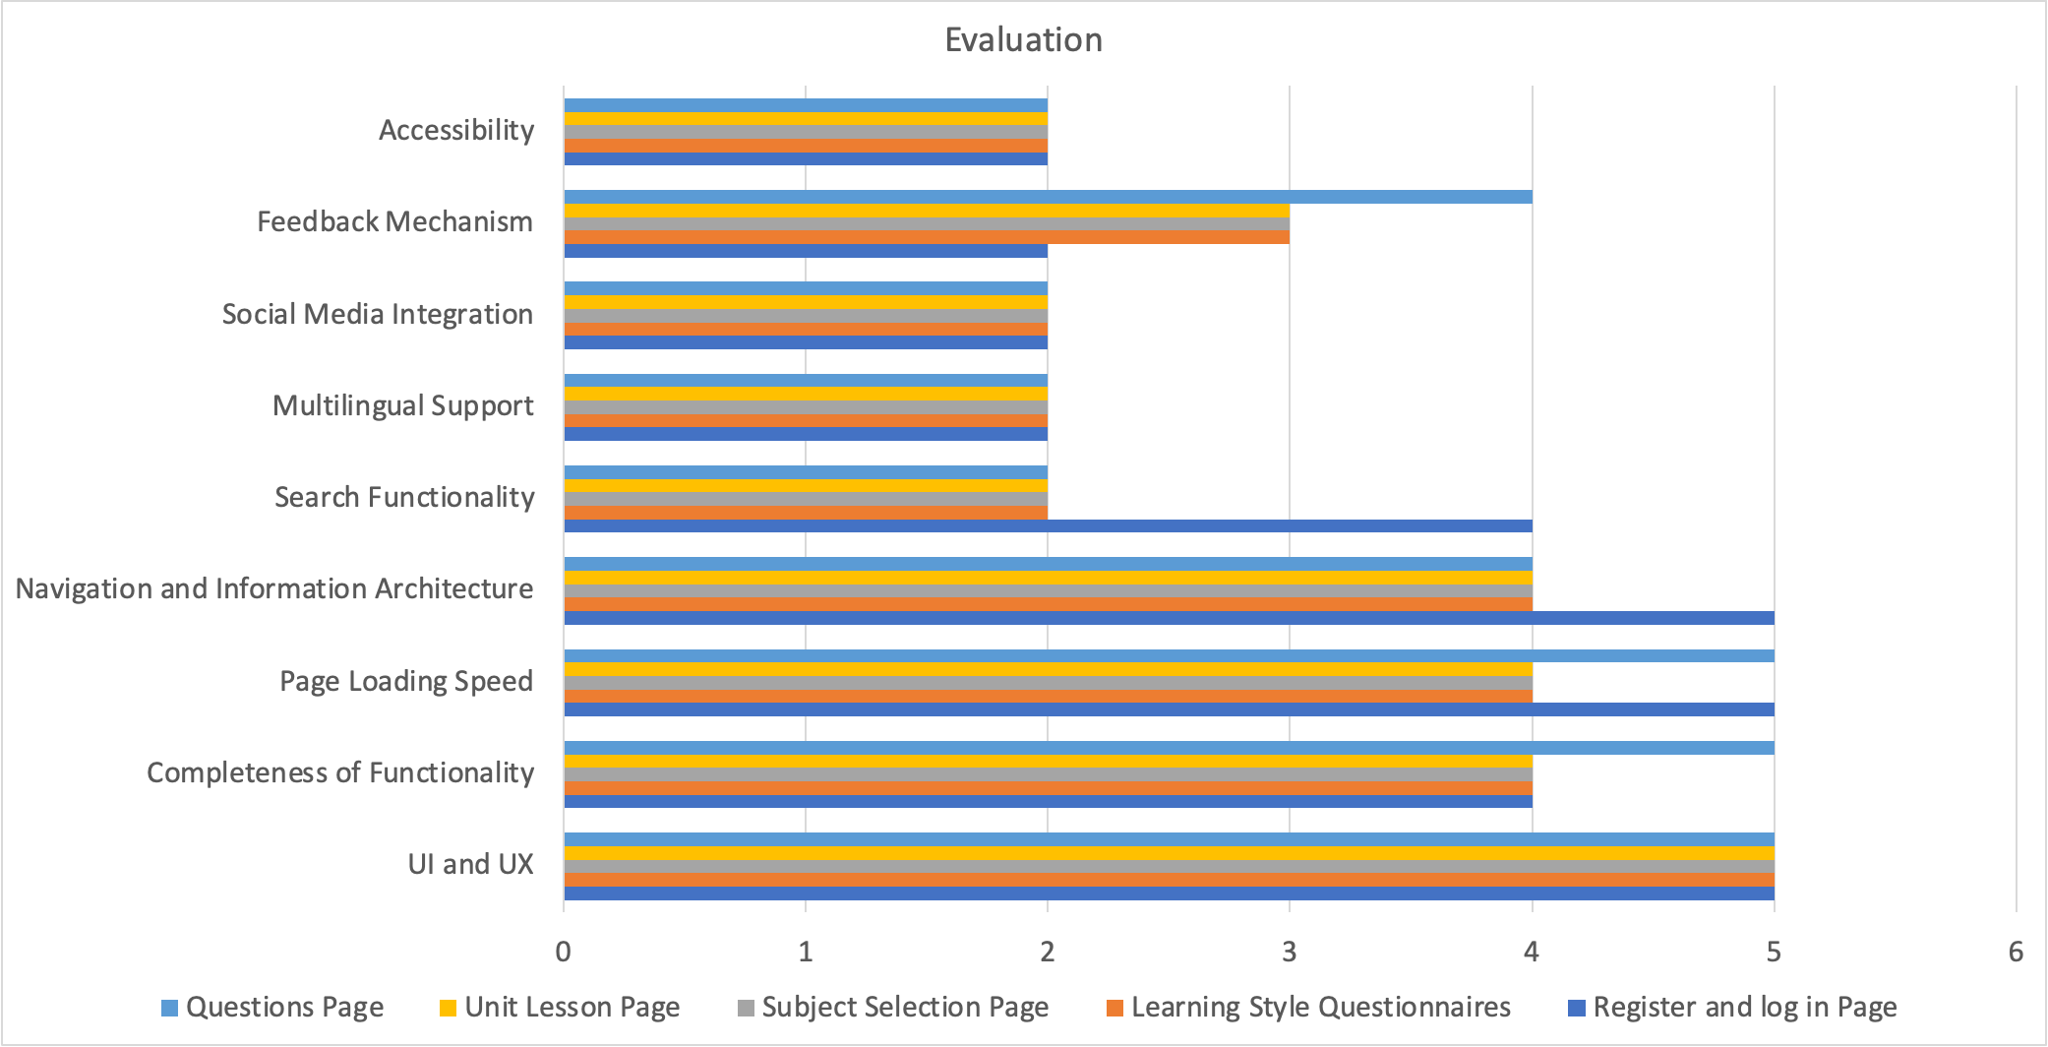
USER SURVEY

Slide 28
Accessibility:
Audit: Utilize specialized agencies and tools to review the platform for accessibility barriers.
WCAG Standards: Aim for WCAG 2.1 AA compliance, emphasizing contrast, text alternatives, and keyboard navigation.
Social Media Integration:
Platform Expansion: Integrate with new and local social media for broader reach.
Metrics & Analysis: Use analytics to measure and refine social sharing efficiency.
FUTURE IMPROVEMENTS
Multilingual Support:
Translation Services: Partner with experts for culturally apt translations.
Language Detection: Use auto-detection to serve content in user's language.
Search Functionality:
Algorithm Enhancement: Optimize search for context, synonyms, and user patterns.
Faceted Search: Implement filters for specific and efficient search results.

Slide 29
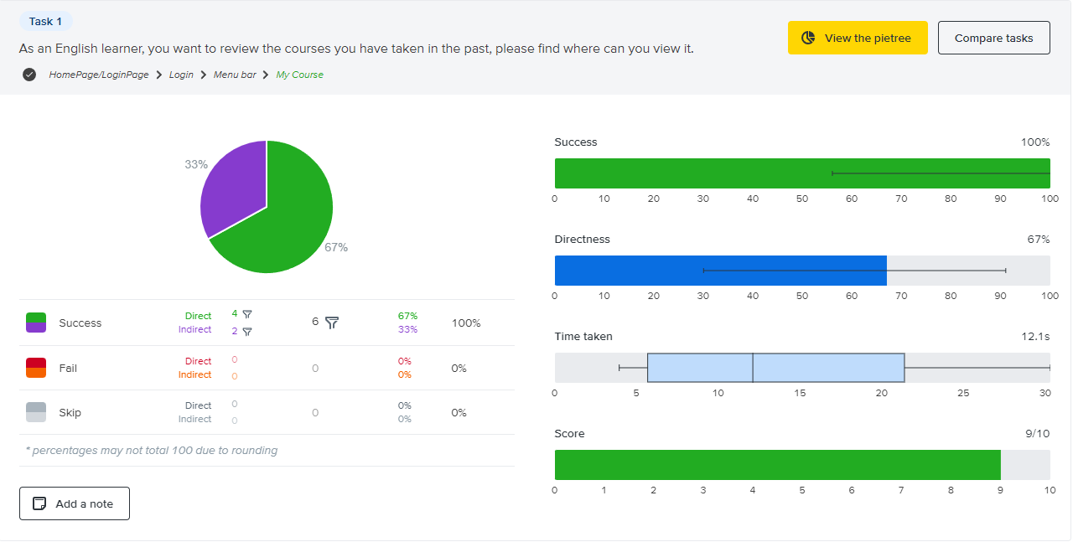
Tree Test
100% Success, 67% Direct Success

Slide 30
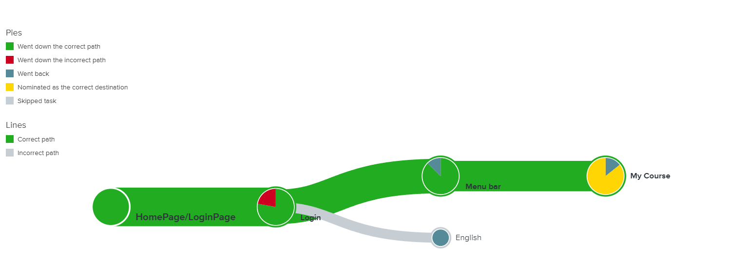
Tree Test

Slide 31
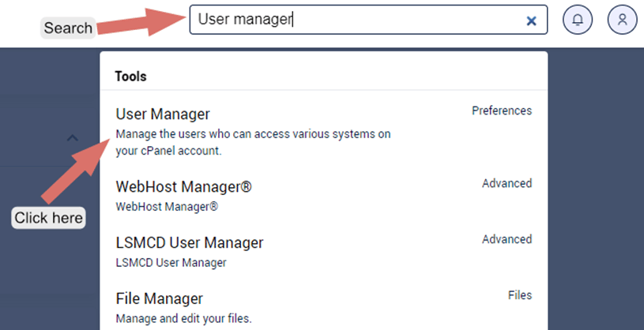
FUTURE IMPROVEMENTS
Add Beginners Guide in the next release
Example

Slide 32
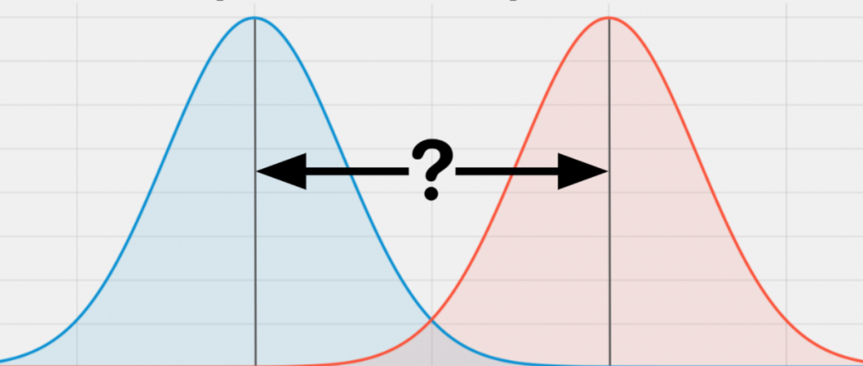
A/B Test
Experimental Procedure:
Six subjects were divided into two groups, three of which were control and the other three were experimental. The control and experimental groups were pretested separately to obtain their average scores before the start of the study.
During the experiment, the experimental group used our service for learning and the control group used the same learning materials but did not use our service. A test was administered at the end of the study to obtain their results at the end of the study.

Slide 33
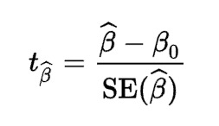
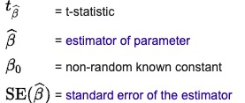
A/B Test
Analysis of results：
Calculate the mean improvement for each group, as illustrated in the previous post.
Calculate the standard deviation for each group. This gives the amount of score variation within each group.
Calculate the t-value using the formula for the t-test. For an independent samples t-test, the formula is: t = (M1 - M2) / sqrt[(SD1^2/n1) + (SD2^2/n2)] where M1 and M2 are the means of the two groups, SD1 and SD2 are the standard deviations of the two groups, and n1 and n2 are the sizes of the two groups.

Slide 34
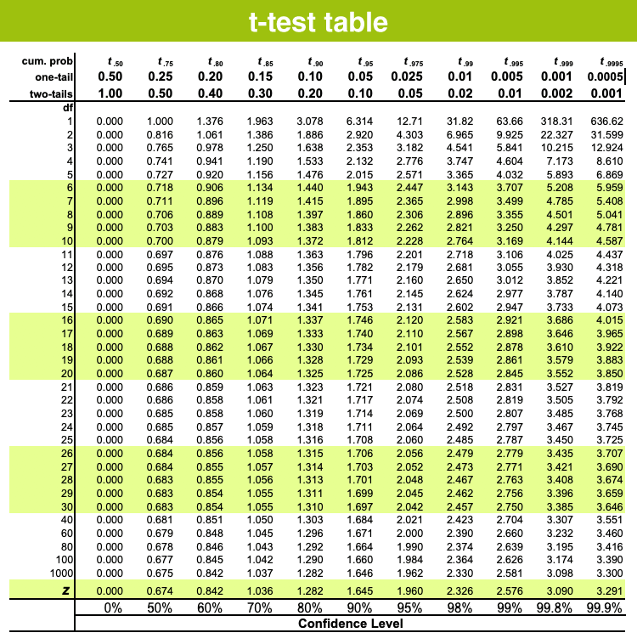
A/B Test
Obtain the p-value corresponding to the t-value either by consulting a statistical table or using a statistical software. The p-value represents the probability of observing the effect you found, or a more extreme one, under the null hypothesis (in this case, that there is no difference between the groups). If the p-value is less than a common threshold of 0.05, we usually consider this as significant, i.e., we consider that the observed effect is unlikely to be just a result of random variation.

Slide 35
6
Sixth PART
Review & Conclusion

Slide 36
Review
No. | Module | Functionality | Completion
1 | Registration & Login | Registration feature (including user verification, email format, and password requirements); Login feature (including user and email verification, password check); | 100%
2 | Learning Style | Undertake a learning style test and save results; | 100%
3 | Course Operations | Course search, selection; View course list functions; Join new course, select learning level and subject; | 100%
4 | Unit Operations | View unit list, start a new unit; Play course video and return to unit list functions; | 100%
5 | Course Quizzing | Quizzing functionality; View quiz feedback (correct or wrong); Practice again; | 100%
6 | AI Feedback | Professional feedback and question answering using OpenAI training, combined with Google Cloud Vision to record learning states (expression data, not actual user images) for personalized learning feedback | 90%
7 | Course Completeness | Procedures after course completion (e.g., return to unit list) | 100%
8 | Multilingual Support | Involves internationalization, localization, resource files, UTF-8 encoding, layout adaptation, language detection, and cultural nuances | 50%

Slide 37
BUT No one is perfect

Slide 38



Lack of trust
Fear of conflict
We seek perfection...
Beginning
Mid-term
<Set criteria>
Management criteria, who is responsible, for what, and for what is accomplished.
<Judge the things not the people>
Use fewer personal pronouns and focus only on things. Focus only on programs that need to be improved

Slide 39
What we learned
Importance of Communication
Continuous improvement and feedback
Enhanced user Involvement
Standardised testing and documentation
Increased agility in development

Slide 40
THANK YOU

